Slide 1
Potato Chip Mailing Contest
Group # 6

Slide 2
Objective/Requirements
Build a 3x5x2 box, steps listed in design slide.

Slide 3
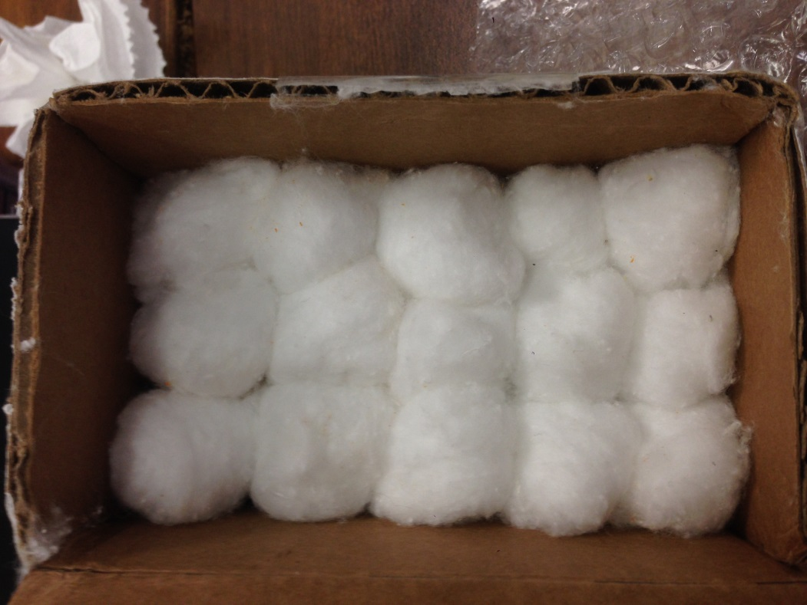
Design Step One
Lay out your first layer of whole,
round cotton all on the flat side.
DO NOT TEAR OR SHRED THE COTTON BALLS
You should have 5 by 3 layout, 15 total.

Slide 4
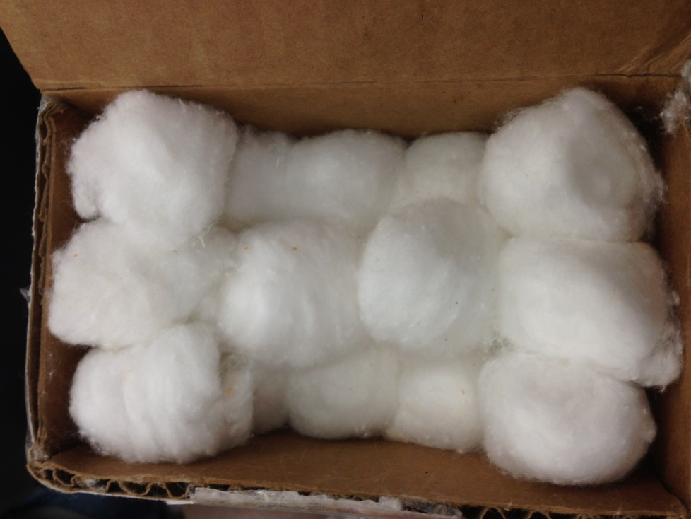
Design Step 2
Lay out the cotton balls in a a capital i shape, it should
Take 8 cotton balls. Two in the middle, and three on each other side. This should hug the chip.

Slide 5
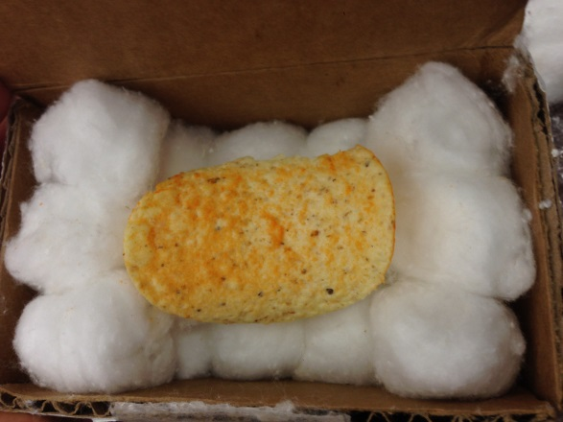

Design Step 3
Place the chip so the that the concave side is on the two cotton balls in the middle.

Slide 6
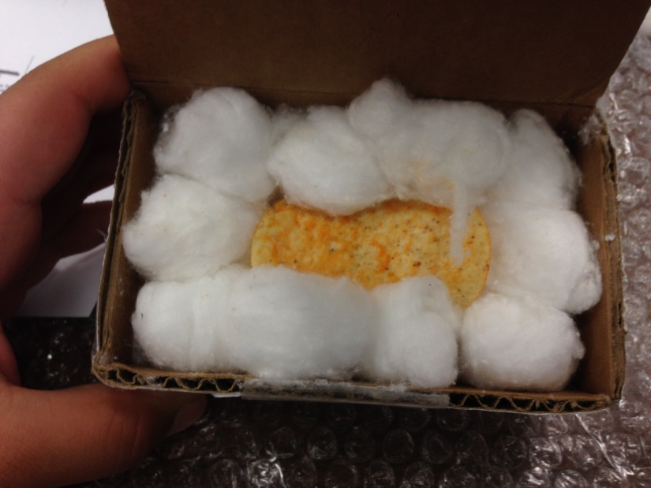
Design Step 4
Surround the chip in the gaps with 4 more cotton balls.

Slide 7
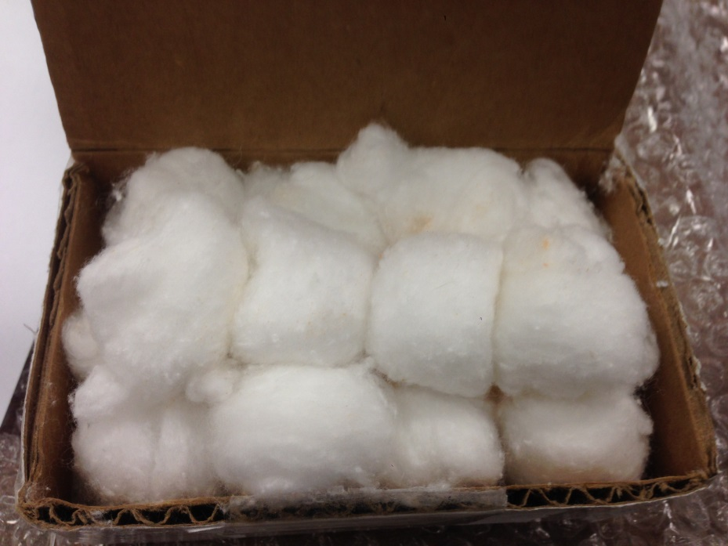
Design Step 5
Place the last pieces directly on top, to completely surround the chip and fill the box up.

Slide 8
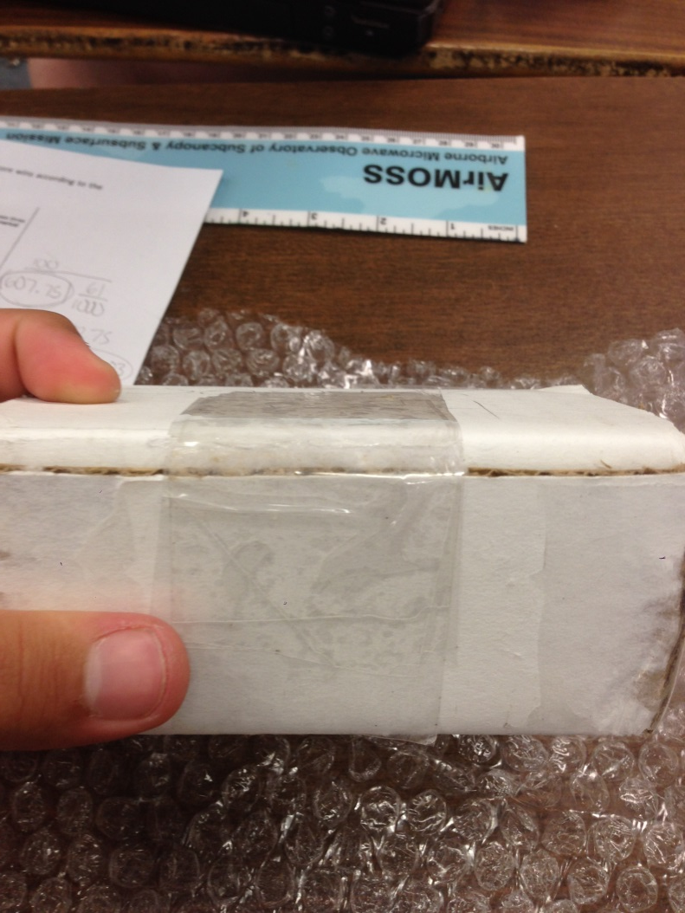
Put the flap in, and it should be ready to tape on. DON’T FORGET TO WRITE FRAGLE.

Slide 9
Predicted Score with Explanation

Slide 10
Parts List
CARDBOARD
31-33 COTTON BALLS.
4 INCHES OF TAPE
SCISSORS

Slide 11

Photo of Mailed Container

Slide 12
Data
Official Score

Slide 13
Lessons Learned
What would you change next time
If your predicted score differed from your actual, why?

